Slide 1
Windows Utilities and DOS Commands

Slide 2
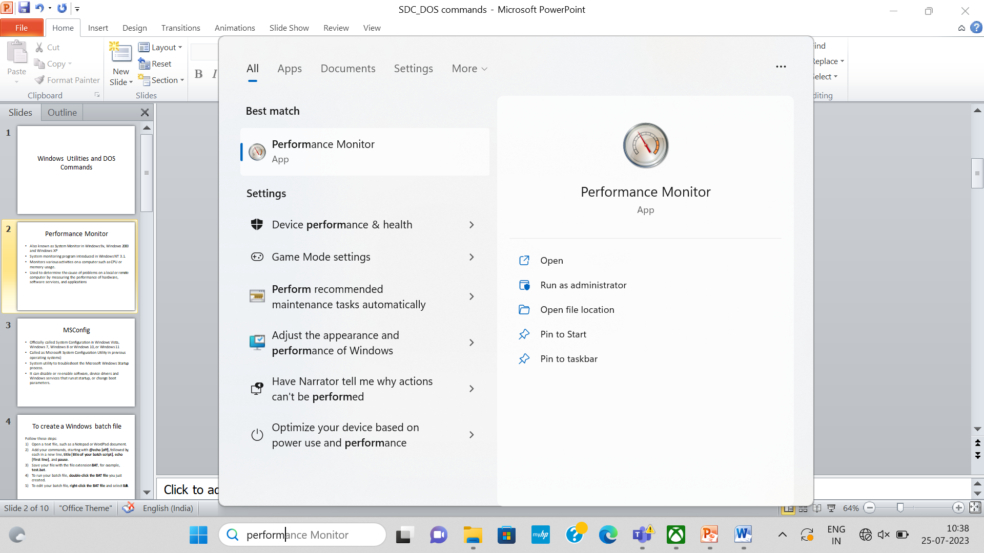
Performance Monitor
Also known as System Monitor in Windows 9x, Windows 2000 and Windows XP
System monitoring program introduced in Windows NT 3.1.

Slide 3
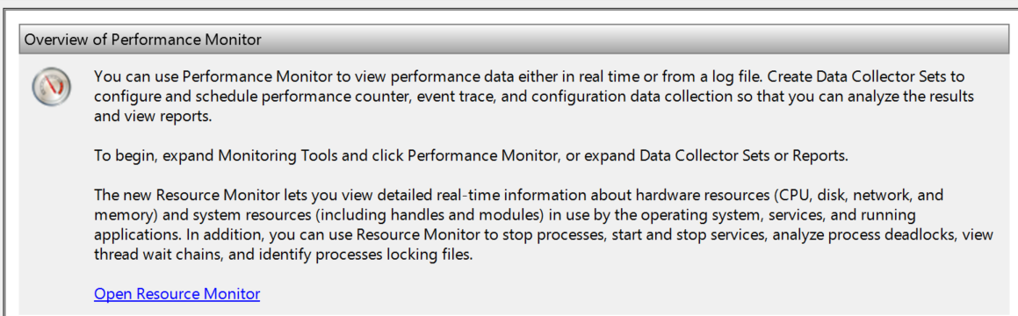
Performance Monitor
Monitors various activities on a computer such as CPU or memory usage.
Used to determine the cause of problems on a local or remote computer by measuring the performance of hardware, software services, and applications

Slide 4
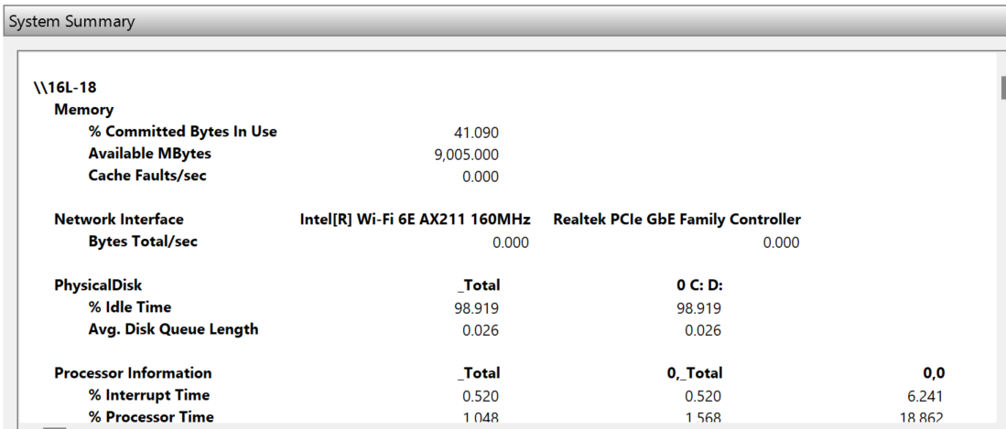
Performance Monitor

Slide 5
MSConfig
Officially called System Configuration in Windows Vista, Windows 7, Windows 8 or Windows 10, or Windows 11
Called as Microsoft System Configuration Utility in previous operating systems)
System utility to troubleshoot the Microsoft Windows Startup process.
It can disable or re-enable software, device drivers and Windows services that run at startup, or change boot parameters.

Slide 6
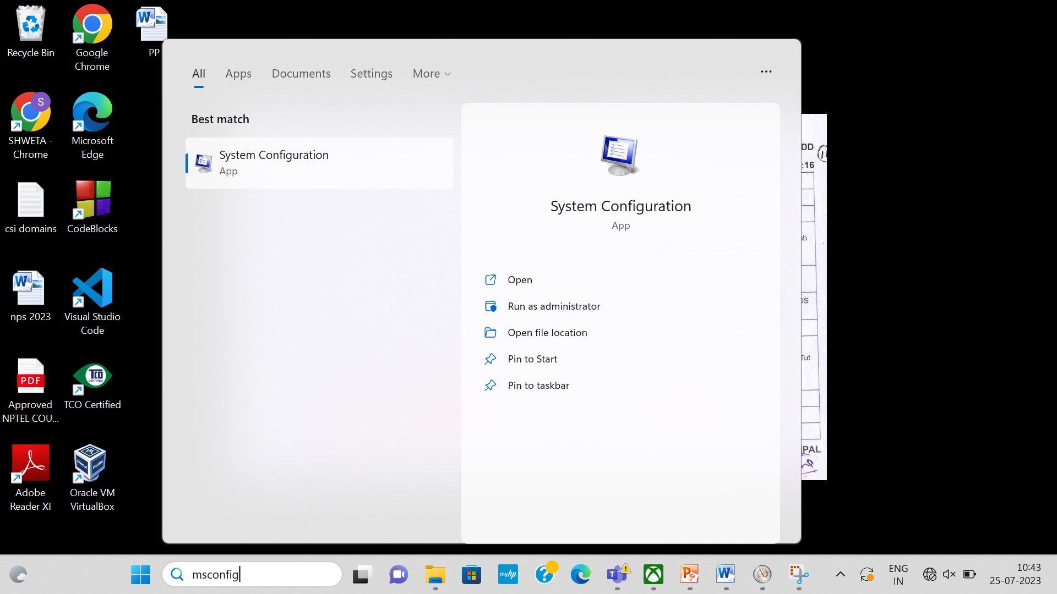
MSConfig or System Configuration

Slide 7
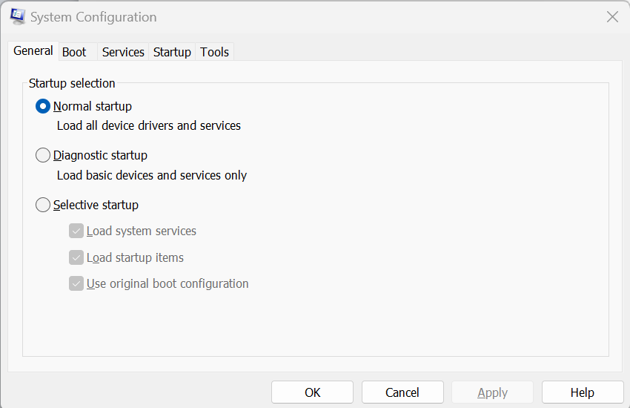
MSConfig or System Configuration

Slide 8
To create a Windows batch file
Follow these steps:
Open a text file, such as a Notepad or WordPad document.
Add your commands, starting with @echo [off], followed by, each in a new line, title [title of your batch script], echo [first line], and pause.
Save your file with the file extension BAT, for example, test.bat.
To run your batch file, double-click the BAT file you just created.
To edit your batch file, right-click the BAT file and select Edit.

Slide 9
To create a Windows batch file
Follow these steps:
Open a text file, such as a Notepad or WordPad document.
Add your commands, starting with @echo [off], followed by, each in a new line, title [title of your batch script], echo [first line], and pause.
Save your file with the file extension BAT, for example, test.bat.
To run your batch file, double-click the BAT file you just created.
To edit your batch file, right-click the BAT file and select Edit.

Slide 10
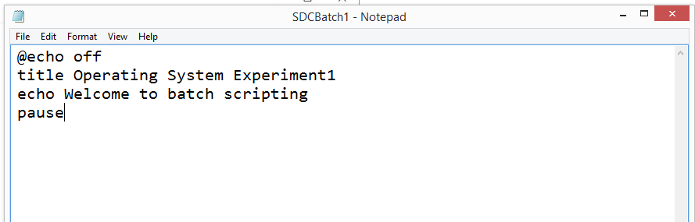
Open a text file, such as a Notepad or WordPad document.
Add your commands, starting with @echo [off], followed by, each in a new line, title [title of your batch script], echo [first line], and pause.
Save your file

Slide 11
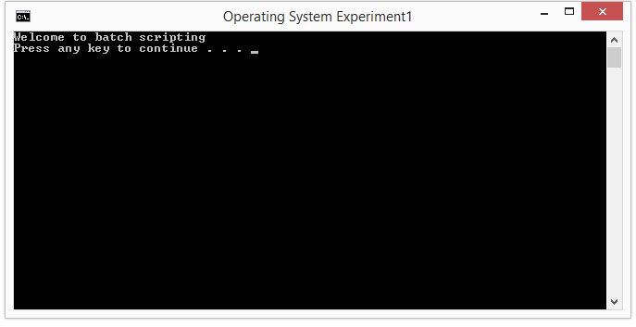
To run your batch file, double-click the BAT file you just created.
To edit your batch file, right-click the BAT file and select Edit.

Slide 12
@echo: This parameter will allow you to view your working script in the command prompt. This parameter is useful for viewing your working code. If any issues arise from the batch file, you will be able to view the issues associated with your script using the echo function.
Adding a following off to this parameter will allow you to quickly close your script after it has finished.
title: Providing much of the same function as a <title> tag in HTML, this will provide a title for your batch script in your Command Prompt window.

Slide 13
pause: Allows a break in the logical chain of your BAT file. This allows for users to read over command lines before proceeding with the code. The phrase "Press any key to continue..." will denote a pause.
start "" [website]: Will head to a website of your choice using your default web browser.

Slide 14
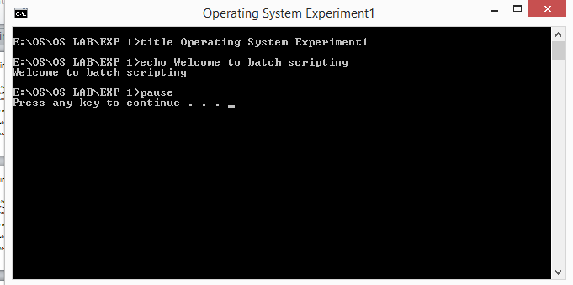
@echo on

Slide 15
Batch File Redirection
Refer to the following page for Batch File Redirection
https://www.robvanderwoude.com/redirection.php

Slide 16
Using the cd Command:
Simply type cd without any arguments and press Enter. The full path of the current working directory will be displayed in the console.
Example:C:\Users\YourUsername\Documents> cd C:\Users\YourUsername\Documents

Slide 17
Using the cd Command:
Simply type cd without any arguments and press Enter. The full path of the current working directory will be displayed in the console.
Example:C:\Users\YourUsername\Documents> cd C:\Users\YourUsername\Documents

Slide 18
Batch Commands
Basic batch commands are all case insensitive and can be used to perform a specific set of instructions:-
DIR – The ‘dir’ command is used to get all the directories, sub-directories, and files present in the current working directory.
CD – The ‘cd’ command is used to change the current working directory.
CLS – The ‘cls’ command is used to clear the screen of the command prompt.
ECHO – The ‘echo’ command is by default ‘on’ but if we turn it off by ‘echo off’ it turns off prompt till the time ‘echo on’ is passed.

Slide 19
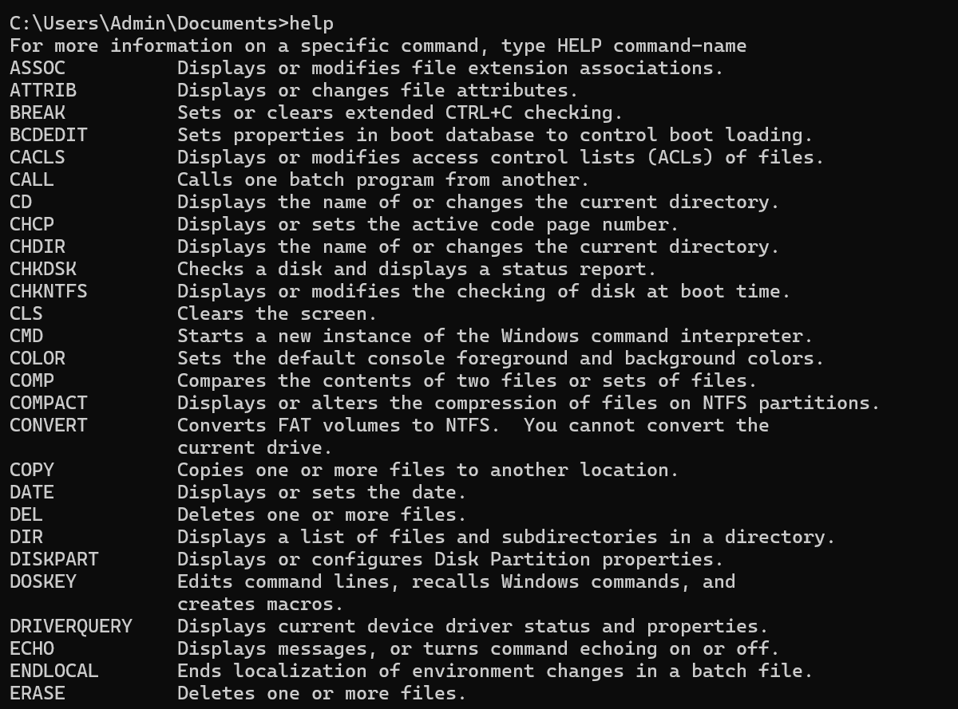
HELP – This command tells us all about the commands available in the cmd. It runs only if the cmd is run as an administrator.

Slide 20
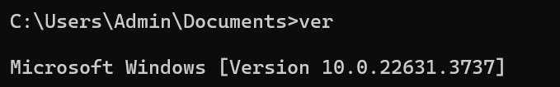
VER – The ‘ver’ command tells the version of the user’s Windows.

Slide 21
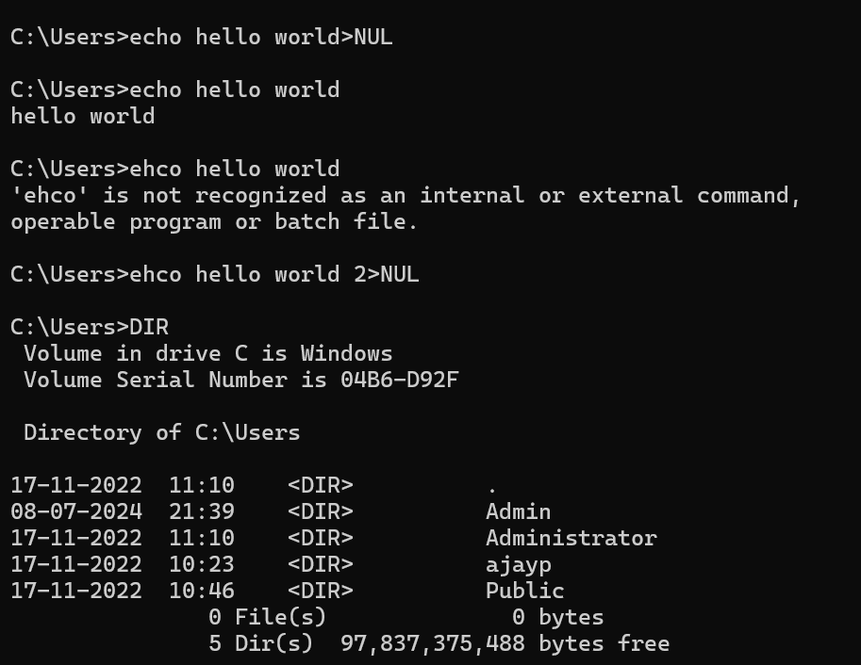
Batch File Redirection

Slide 22
These streams are:
Standard Output
Standard Error
Console

Slide 23
Standard Output is the stream where all, well, standard output of commands is being sent to. The ECHO command sends all its output to Standard Output.
Standard Error is the stream where many (but not all) commands send their error messages.
And some, not many, commands send their output to the screen bypassing Standard Output and Standard Error, they use the Console. By definition Console isn't a stream.

Slide 24
There is another stream, Standard Input: many commands accept input at their Standard Input instead of directly from the keyboard. Probably the most familiar example is MORE:
DIR /S | MORE
where the MORE command accepts DIR's Standard Output at its own Standard Input, chops the stream in blocks of 25 lines (or whatever screen size you may use) and sends it to its own Standard Output.

Slide 25
1 for Standard Output and
2 for Standard Error.

Slide 26
Now make a typo again:
EHCO Hello world 2>NUL
What did you get?
Nothing
That's because the error message was sent to the Standard Error stream, which was in turn redirected to the NUL device by 2>NUL

Slide 27
You may be familiar with "redirection to NUL" to hide command output:
ECHO Hello world>NUL
Will show nothing on screen.
That's because >NUL redirects all Standard Output to the NUL device, which does nothing but discard it.

Slide 28
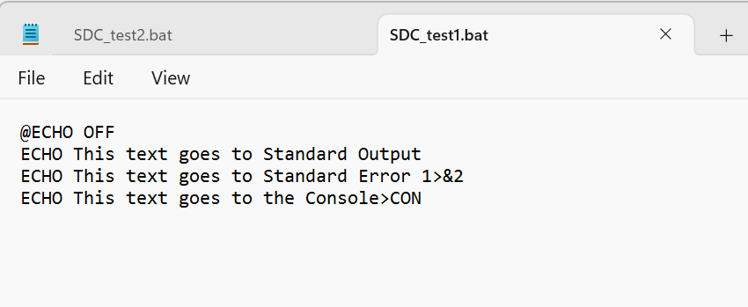
SDC_test1.bat

Slide 29
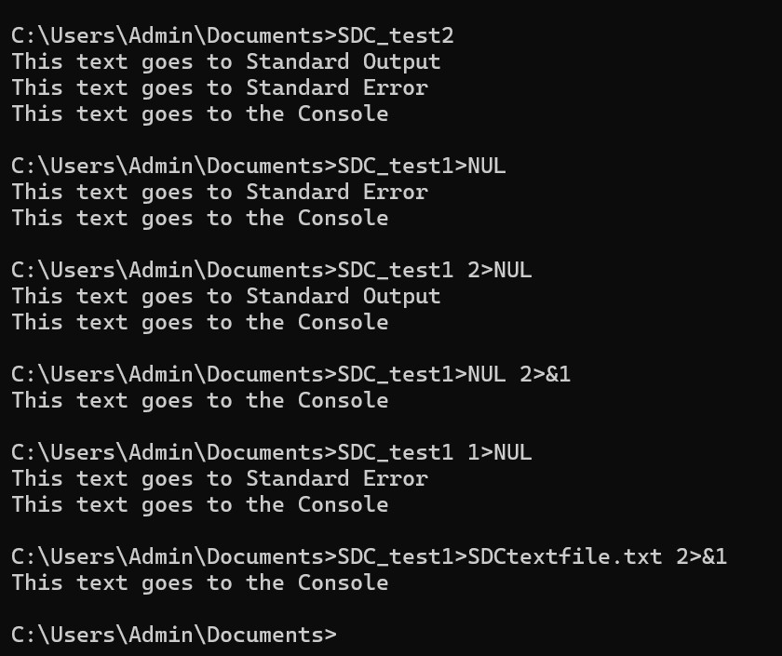

Slide 30
Run test.bat in CMD.EXE, and this is what you'll get:
C:\>test.bat This text goes to Standard Output This text goes to Standard Error This text goes to the Console C:\>_

Slide 31
Now let's see if we can separate the streams again.

Slide 32
Run:
test.bat > NUL and you should see:
C:\>test.bat
This text goes to Standard Error
This text goes to the Console
We redirected Standard Output to the NUL device, and what was left were Standard Error and Console.

Slide 33
Next, run:
test.bat 2> NULand you should see:
This text goes to Standard Output
This text goes to the Console C:\>_
We redirected Standard Error to the NUL device, and what was left were Standard Output and Console.

Slide 34
Nothing new so far.
But the next one is new:
test.bat > NUL 2>&1
and you should see:
C:\>test.bat
This text goes to the Console
This time we redirected both Standard Output and Standard Error to the NUL device, and what was left was only Console. It is said Console cannot be redirected

Slide 35
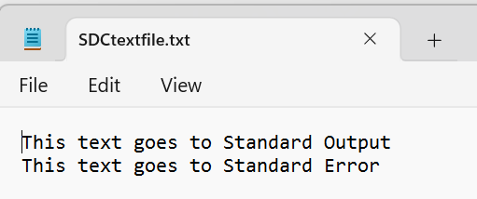
Run:
test.bat > test.txt 2>&1
you'll get this text on screen (we'll never get rid of this line on screen, as it is sent to the Console and cannot be redirected):
This text goes to the Console
You should also get a file named test.txt with the following content:
This text goes to Standard Output This text goes to Standard Error

